Slide 1
Dream Fusion
Text-to-3D
Using 2D Diffusion
Fung Ho Kit 3035779105
Zhang Yuhan 3035771672
Jing Jingderong 3035771775
Notes:
Hey guys, welcome to the presentation of DreamFusion text-to-3D using 2D Diffusion

Slide 2
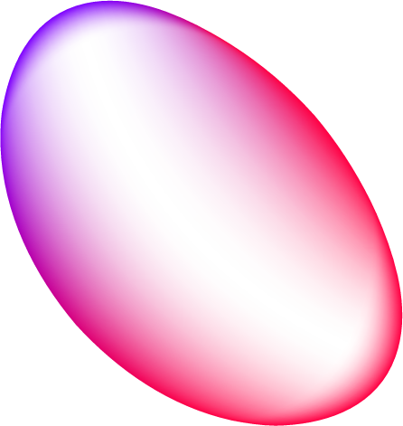
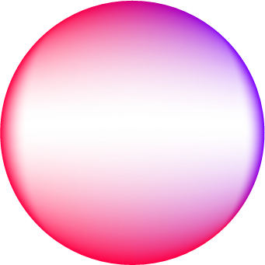
Table of contents
01
02
Introduction
Reproduction & Analysis
03
04
Improvement
Q&A Session
Notes:
The presentation will be separated into 3 main sections, the Introduction Part, the Reproduction and Analysis Part and the Improvement Part. We are also welcomed for any questions regarding our presentation.

Slide 3
01
Introduction
Notes:
Break for 1 sec and scroll to next page

Slide 4
01.1
Introduction
Replicate and examine "DreamFusion: Text-to-3D Using 2D Diffusion"
Novel approach for text-to-3D synthesis
No need for 3D training data or image diffusion model modifications
Notes:
In this presentation, we will discuss our efforts to replicate and critically examine the results of the paper "DreamFusion: Text-to-3D Using 2D Diffusion," which is a novel approach for text-to-3D synthesis that does not require 3D training data or modifications to the image diffusion model.

Slide 5
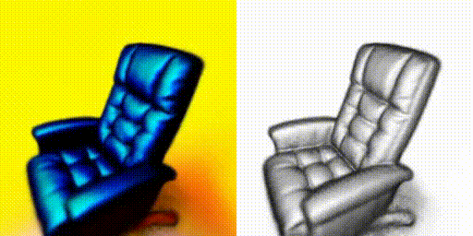
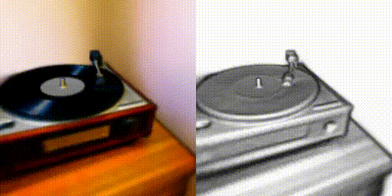
01.2
DreamFusion Overview
Probability density distillation-based loss functions
Generates 3D models from Neural Radiance Fields (NeRF)
Optimizes via gradient descent for photorealistic results
Potential applications: gaming, entertainment, architecture
Notes:
DreamFusion introduces probability density distillation-based loss functions and generates 3D models from randomly initialized Neural Radiance Fields (NeRF) using a DeepDream-like procedure. These models can be optimized via gradient descent to achieve photorealistic results from any camera viewpoint. The potential applications of text-to-3D generation span gaming, entertainment, and architecture, making a deeper investigation of DreamFusion essential.

Slide 6
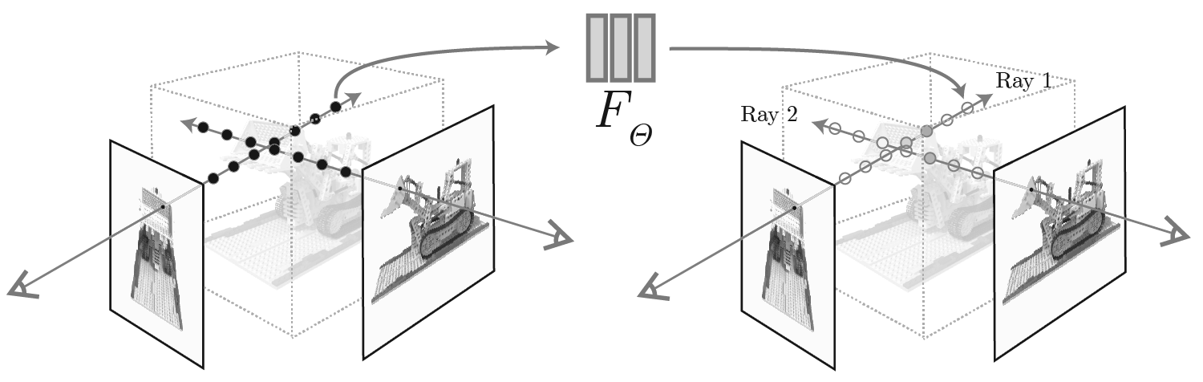
01.3
Model Description: mip-NeRF 360
Neural Radiance Field (NeRF) algorithm
Randomly initialized for each caption
Trained using images to learn radiance values
Tailored to specific scene descriptions
Notes:
The DreamFusion algorithm consists of a modified mip-NeRF 360 model and a diffusion model called Imagen. The NeRF algorithm represents a given scene and is randomly initialized for each caption (i.e., textual description of the scene). The model is trained from scratch using images of the scene to learn radiance values for each point in space, allowing it to be tailored to each specific scene description and generate accurate 3D representations.

Slide 7
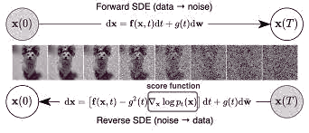
01.4
Model Description: Diffusion Model
Utilizes latent variables to generate new data samples
Gradually transforms samples from noise distribution to data distribution
Reversible transformations
Notes:
The diffusion model is a generative model that utilizes latent variables to generate new data samples, designed to gradually transform a sample from a tractable noise distribution towards the data distribution. The model learns to model the probability density function of the data distribution through a series of reversible transformations.

Slide 8
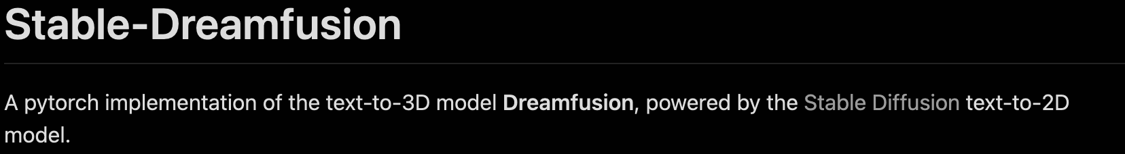
Third-Party Reproduction Differences
01.5
Reproduction backbone choose: Instant-NGP NeRF backbone instead of Vanilla NeRF backbone to achieve faster rendering speed (around 10 frames per second at 800 x 800 resolution).and less GPU memory use (around 16GB GPU memory)
Code contributor: ashawky from GitHub
 | DreamFusion: text-to-3D Using 2D Diffusion | Stable-DreamFusion
Main Model | Conditional Imagen Model | Stable-Diffusion Model
Operation Method | Operates on the image space | Operates on the latent space, requires extra time for propagating the loss back from VAE
Notes:
For the reproduction of the original study,since the original study didn’t provide an open source code to replicate, we found a reliable third-party code called stable-dreamfusion, contributed by Ashawkey from GitHub. But there are some notable differences from the original paper. The Imagen model is not publicly available, so the Stable Diffusion model is used instead. The reproduction code operates on a latent space rather than the original image space, which required introducing extra time cost in training by propagating the loss back from the VAE's (Variational AutoEncoder) encoder part. Additionally, a multi-resolution grid encoder from torch-ngp was used to implement the NeRF backbone, achieving faster rendering speeds and less GPU memory use (around 10 frames per second at 800 x 800 resolution).

Slide 9
01.6
Why DreamFusion?
DreamFusion's promising approach to text-to-3D synthesis
Extra dimension compared to traditional text-to-2D synthesis
Expands potential applications of text-to-image synthesis
Aims to explore possibilities and boundaries of 3D modeling
Notes:
Overall, DreamFusion presents a promising approach to text-to-3D synthesis. With one more dimension added, the model expands the potential applications of text-to-image transformation. By exploring its potential applications and limitations, we aim to shed more light on the possibilities and boundaries of this innovative approach to 3D modeling.
Next, may groupmate will demonstrate more details about the model reproduction and analysis.

Slide 10
02
Reproduction & Analysis

Slide 11
Demo Trials
Coherence Reproduction
Ablation Test Reproduction
Notes:
Then I will show our work on reproducing part. We explored the demo trials, coherence reproduction, and ablation test reproduction, aiming to identify the strengths and weaknesses of the model.

Slide 12
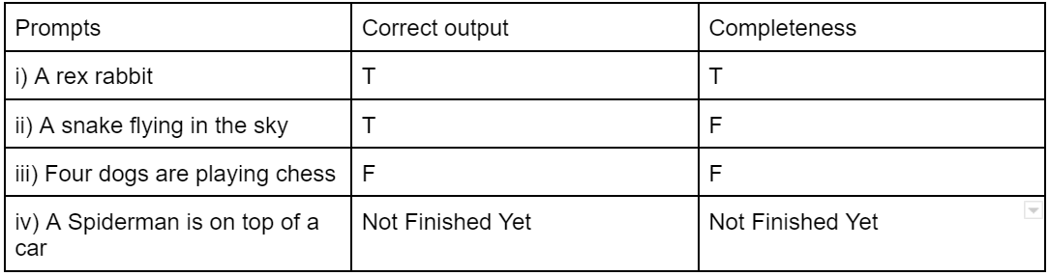
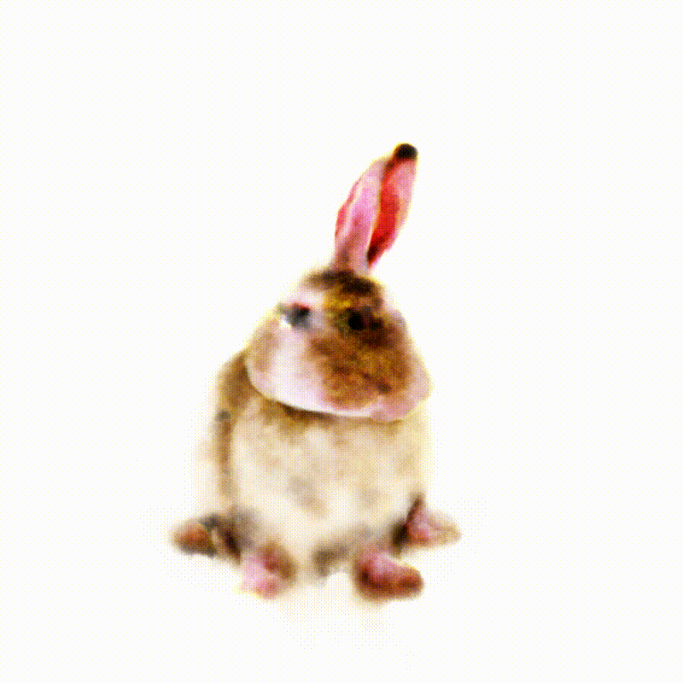
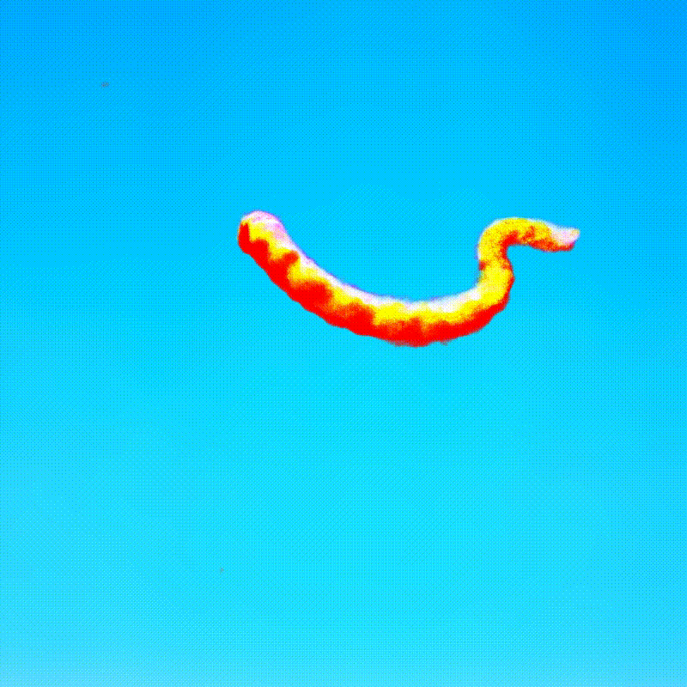
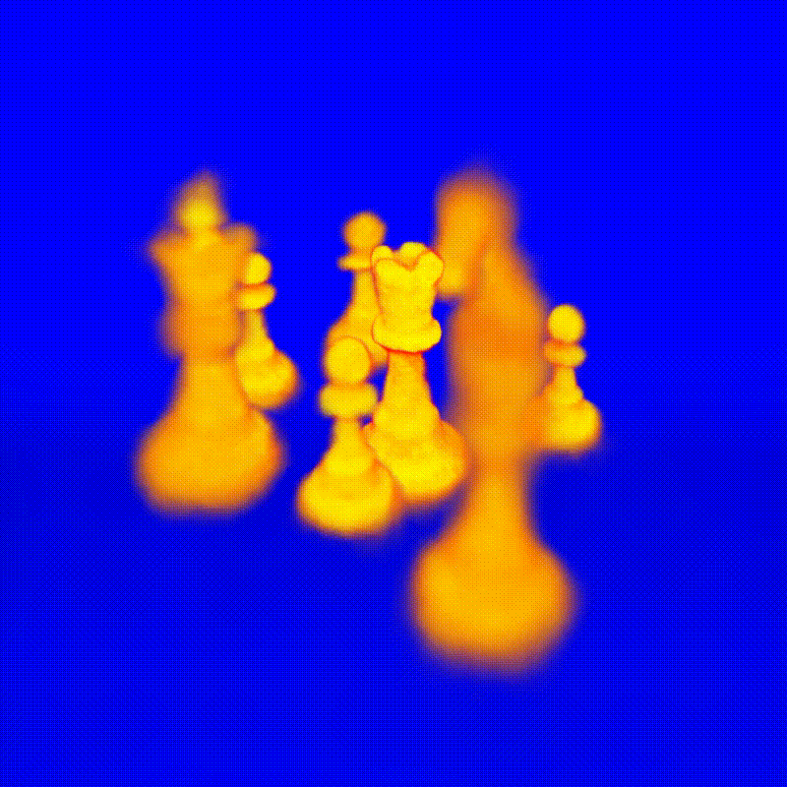
Demo Trials
Notes:
In demo trials, we investigated the capability of third-party reproduction and leveraged the complexity of the prompts to examine the boundary. We considered four cases: (i) Complex species names like rex rabbit, which only have one ear (ii) Objects with additional descriptors, (iii) Multiple objects, and (iv) Positional indications. Our demo trials results highlighted both the correctness and completeness of the model's output.

Slide 13
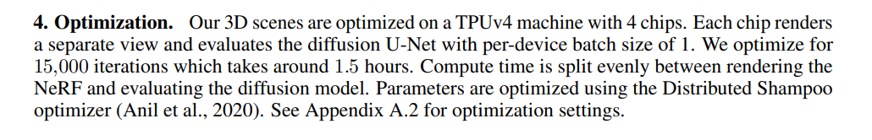
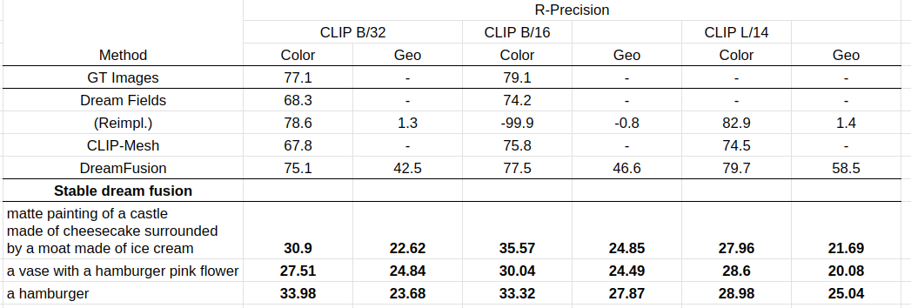
Coherence Reproduction
We only run 10000 iteration with 1 hours on GPU A3070
Notes:
We also reproduce the coherence of 3D generation and verify the claims made in the original paper. By feeding the model with the same prompts and measuring R-Precision, we assessed the gap in performance between different models. These prompts were taken from the original paper, and we used both first priority and backup prompts for our coherence reproduction tests. The results for Stable DreamFusion has a better performance on Geometric. As for Color, because we only run 10,000 iteration with 1 hours on GPU A3070 with 100 epochs, the result only reach 50%~60% compared with other methods . With longer epoch and higher computation power, it can perform better.

Slide 14
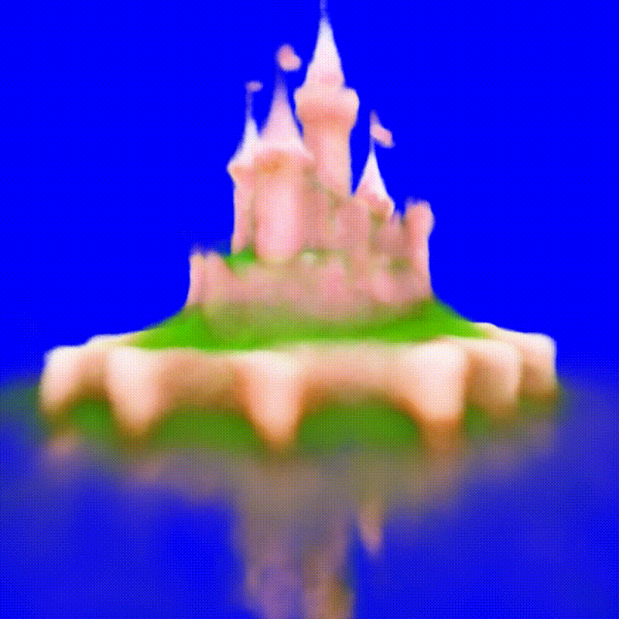
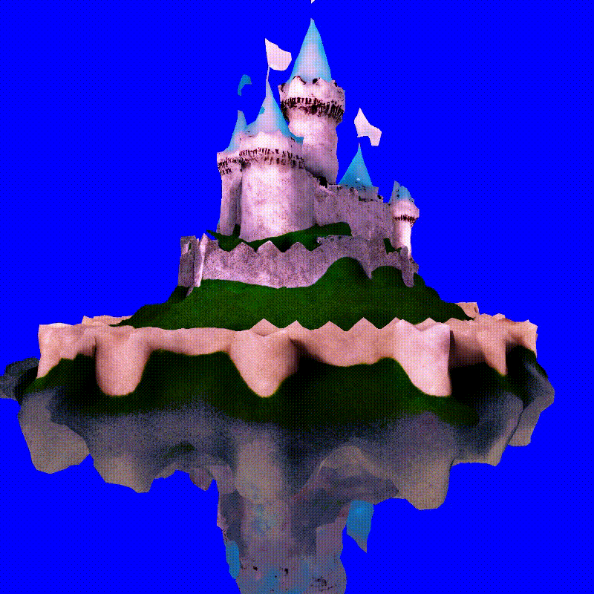
Coherence Reproduction
Text:
matte painting of a castle made of cheesecake surrounded by a moat made of ice cream
DMTet finetuning
Notes:
Our analysis of the demo trials highlighted several issues, such as missing details, texture, and single-object focus. We proposed improving the prompts, using an AI model to complete short prompts, and applying DMTet to finetune the results in the code realization. Here is an example after applying DMTet finetuning.

Slide 15
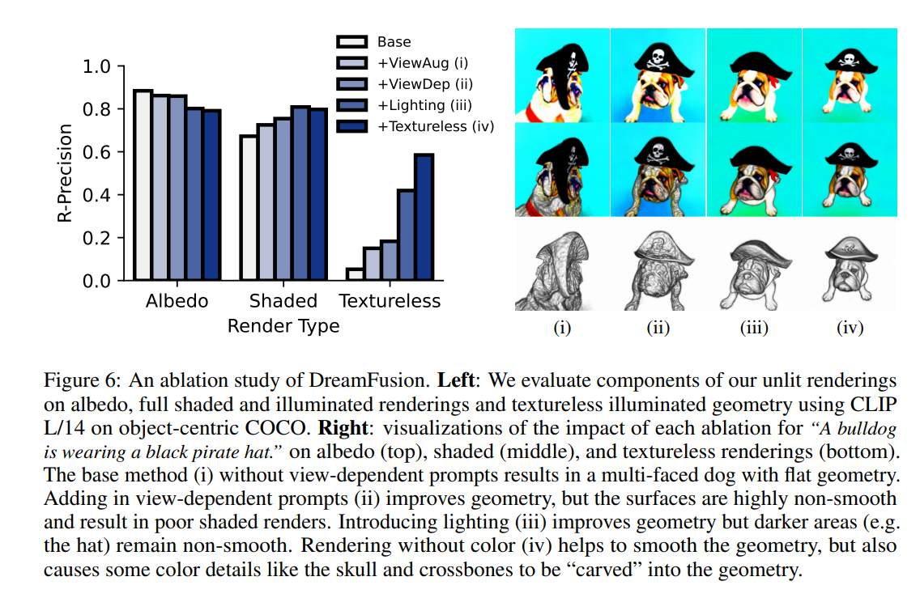
Ablation Test Reproduction
(i) ViewAug:
Without view-dependent prompts
(ii) ViewDeep:
Improve geometry
(iii) Lighting:
Improve geometry
(iv) Texttureless:
Smooth the geometry
Notes:
Our goal to reproduce the ablation study is to examine the effects of four components on third-party reproduction: (i) ViewAug, (ii) ViewDep, (iii) Lighting, and (iv) Textureless like the original paper. We used a base prompt and added each component to observe the performance. And as the paper described, view-dependent prompt, with lighting and rendering without color do help improve the generation quality

Slide 16
CUDA_OUT_OF_MEMOTY&
Long Fitting Time
Notes:
However, we also encontered the 'CUDA_OUT_OF_MEMORY' error when feeding long text prompts in this part, indicating resource constraints for non-giant companies. Besides, it needs about 2 and a half hours to get one 3D model which is not convenient as well

Slide 17
03
Improvement
Notes:
Ok, Next I will introduce the improvement part

Slide 18
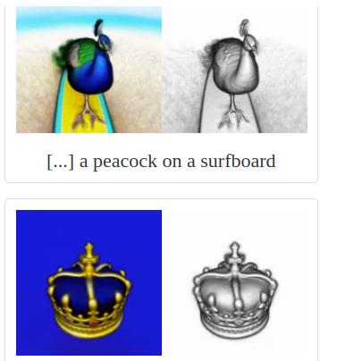
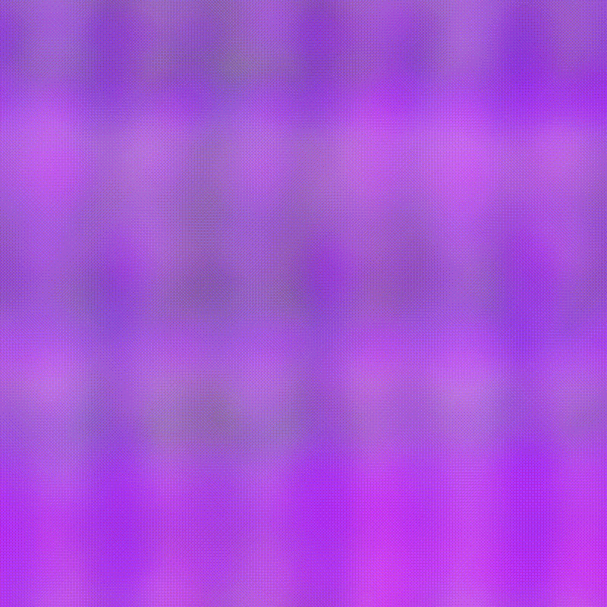
Limitation
of Dream Fusion
03
Fail to generate multiple objects
GPU Resources Occupation
Omit a significant amount of information
Dream Fusion
Art Gallery
Our generation
Notes:
Firstly, let's look into the limitations of dream fusion.
The biggest challenge we observe is that dream fusion can only produce a single object. It is quite limited considering the increased demand for AI-generated content. It is better for us to investigate whether there are means to unleash the potential of this text-to-3D tool.
Also, another constraint we met is that the generation will cause a large GPU resource Occupation. When we attempted to run a task with a more complex conditioning, it will collapse with the error of GPU out of memory. As we all know, GPUs nowadays are still scarce resources, this drawback will prevent the possibility of small-size companies or individuals from using this tool.
Moreover, the current process is that the program recognizes one key object stated in the prompt and tries to fulfill the descriptions. It will cause the attention to focus on a narrow scope and ignore a large amount of information in the prompt.

Slide 19
Our Pipeline
Keyword Extraction
1
2
3
Relationship Mapping
3D mesh Editing
Notes:
Therefore, we propose our new pipeline. We have 3 stages: Keyword extraction, relationship mapping, and 3D mesh editing. The advantage of our pipeline is that we utilize the concept of divide-and-conquer to break down the task. While more information is processed, the GPU occupation problem can also be relieved.

Slide 20
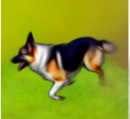
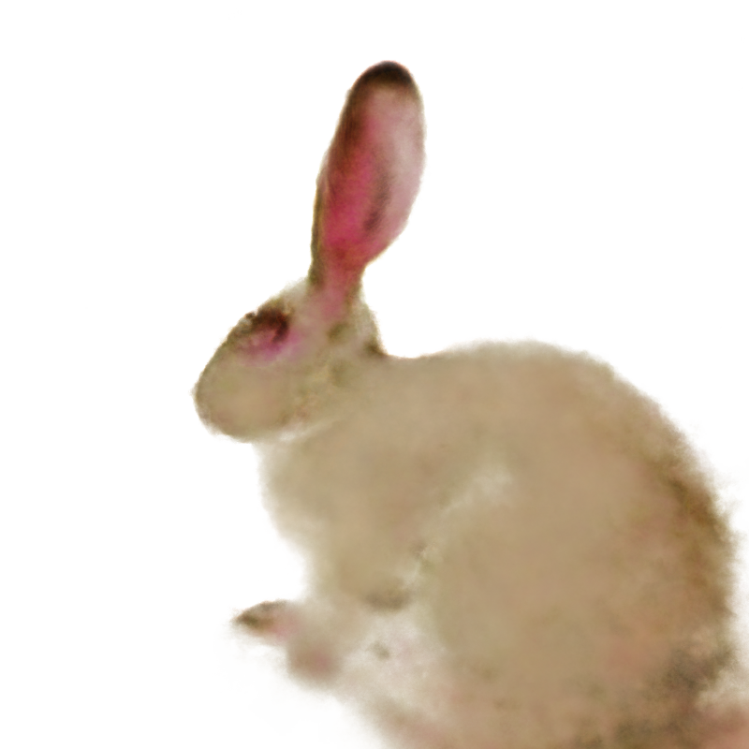
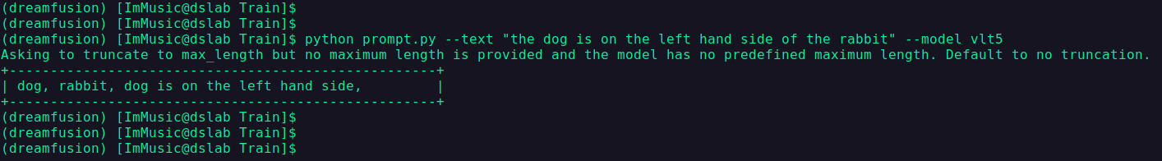
Prompt - Keyword Extraction
Original input : dog is on the left hand side of the rabbit
1
Vlt5 / XLNet / Bert
Dog
Rabbit
Left
2
Stable
Dream Fusion
Notes:
First of all, we have a preprocessing for the prompt. Since the prompt may contain a large amount of information, instead of simply feeding the prompt into the program, we first extract keywords. For example, in our sample prompt “Dog is on the left-hand side of the rabbit”, 2 kinds of keywords will be separated - Objects such as dog as rabbit and relationships such as the positional terms. We have investigated 3 candidate models - Bert, XLNet, and vlt5. And after several trials, we suggest using vlt5 since it can handle the short prompt compared to the counterparties. Actually, our code incorporates all 3 models and allows the users to choose the one they want. After the extraction, we will feed the objects into the stable dream fusion to generate the objects

Slide 21
2. Relationship - RelNet (GNN)
Initial thought
Dog
Rabbit
Left
…
…
Above
Left
Facing
Away
…
Notes:
Step 2 will be relationship mapping. Our initial and ideal method is to use a Graph neural network since GNN allows more complicated relationship mapping formed. However, our team currently is not able to implement that due to the time limit.

Slide 22
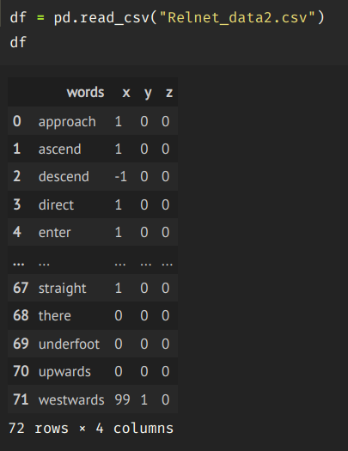
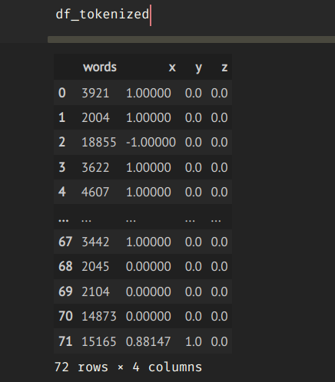
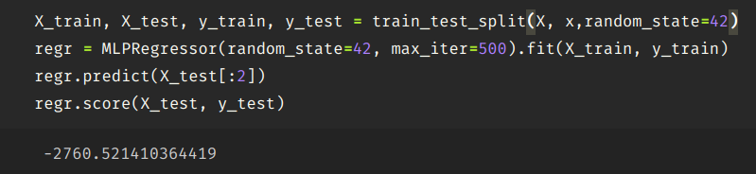
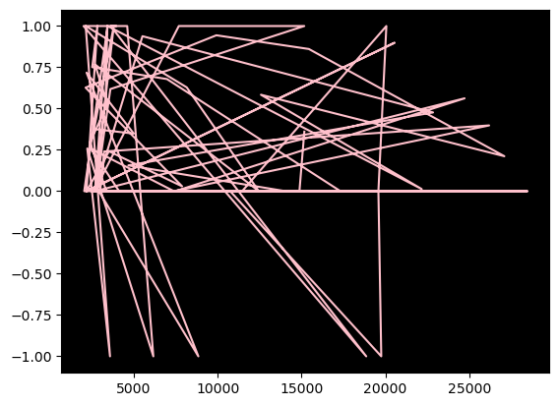
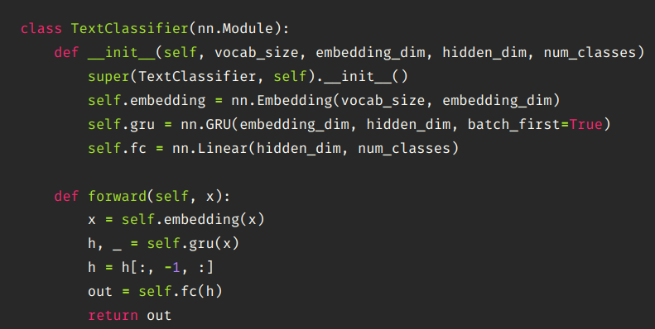
2. Relationship -
RelNet (FFN)
Second Trial
Left
Notes:
The second trial is that we train a deep neural network to recognize the relationship keywords and translate the keywords into a 3D vector which is to recognize the positional differences. As you can see, The graph reveals a messy correlation between the word tokens and the positional 3D vector so the model fails to contribute to the relationship mapping.

Slide 23
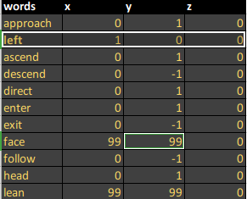
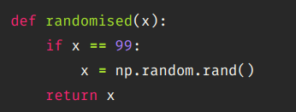
2. Relationship -
RelNet (Rule base)
Flexible solve -
Rule Base Method
Left
Transformat vector
(1,0,0)
Notes:
Therefore, for the temporary completeness of our pipeline, we propose to use the rule base method to convert the keywords into the transformed vector which indicates the distance in the x, y, and z-axis.

Slide 24
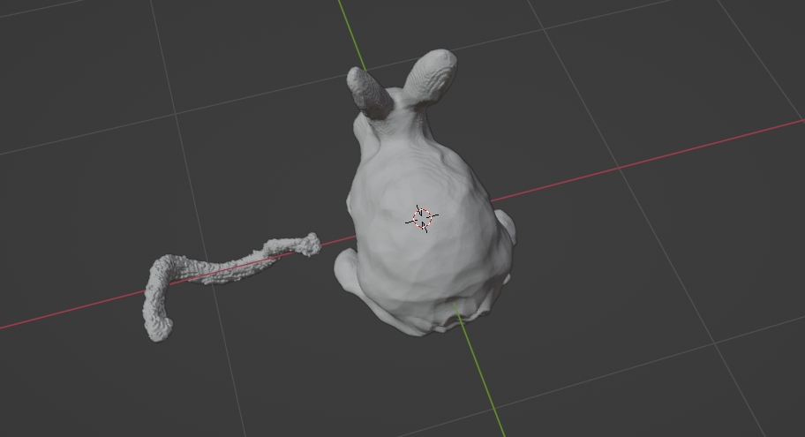
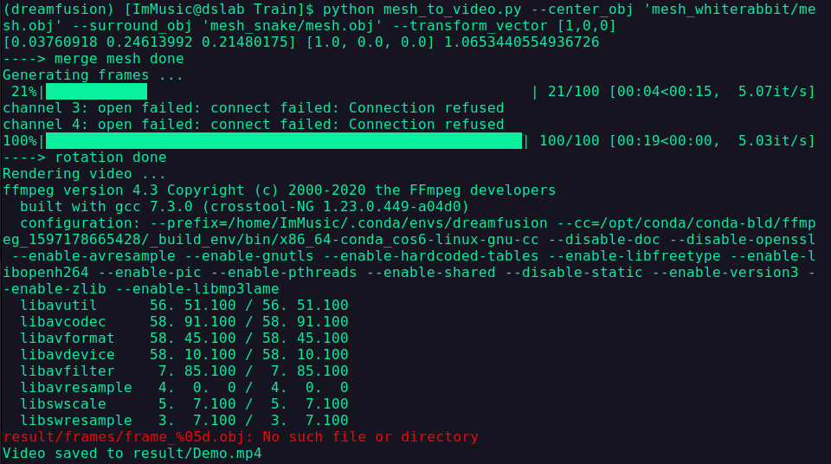
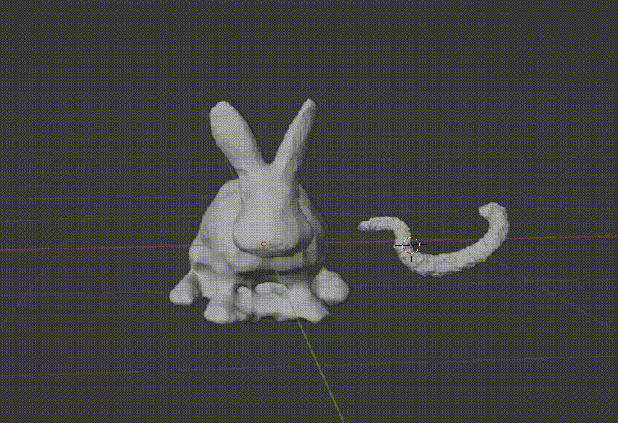
3D model - Editing and rendering
Trimesh + (pyvista)
python mesh_to_video.py --center_obj 'mesh_whiterabbit/mesh.obj'
--surround_obj 'mesh_snake/mesh.obj' --transform_vector [1,0,0]
Notes:
Finally, in mesh editing, we use the object files generated from the stable dream fusion and the transformed vector as the arguments to obtain the final transformed mesh. Here is our code sample and the demo. Here we use a snake to replace the dog for a clearer visual explanation

Slide 25
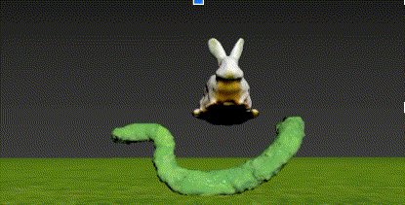

Future Work
Automate the pipeline
Enhance the generation quality
Enable more DOF
Notes:
Although our pipeline can achieve considerable benefits. there are various future works that can be done. For example, we need to research more on building the relationship mapping for the complete automated pipeline. Also, besides focusing on quantity, we should try to improve quality, considering that the dream fusion uses low-resolution image space supervision on NeRF. Last but not least, the pipeline should allow for more degree of freedom, currently the pipeline only considers the relationship in x,y, and z-axis. There are more contents in the 3D realm, such as the angle of the objects and the lighting.

Slide 26
Thanks!
Any question?
Notes:
Here is all of our presentation. Thank you

